Slide 1
课件编辑说明
版本要求
本课件需用office2010及以上版本打开，如果您的电脑是office2007及以下版本或者WPS软件，可能会出现不可编辑的文档。
乱码问题
如您在使用过程中遇到公式不显示或者乱码的情况，可能是因为您的电脑缺少字体，请登录网站www.canpointgz.cn/faq下载。
联系我们
如您还有其他方面的问题，请登录网站www.canpointgz.cn/faq，点击“常见问题”，或致电010-58818058。

Slide 2

新高考版

Slide 3

第3讲
图表图画类

Slide 4
图表图画类作文是2022年全国乙卷出现的一种新型考查方式,多以说明文为主,以短文投稿、调查报告等形式出现。此类作文主要是一些关于情况调查、生产、销售、发展进程等各种项目统计的示意图,并配有提纲文字,要求考生能够精准地描述图表或图画里的现象,分析其中原因并提出自己的见解,以达到透过现象看本质的目的。
专题导读

Slide 5
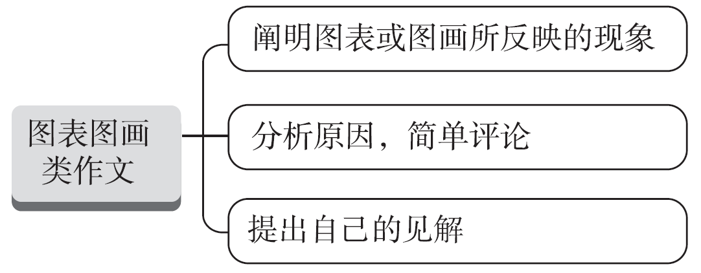
【写作架构】
专题导读

Slide 6
【高考体验】
[2022·全国乙卷]
学校英文报正在开展以Learning English beyond the classroom为题的讨论。请使用图表中的调查结果写一篇短文投稿,内容包括:
1.学习活动状况描述;
2.简单评论;
3.你的建议。
专题导读

Slide 7
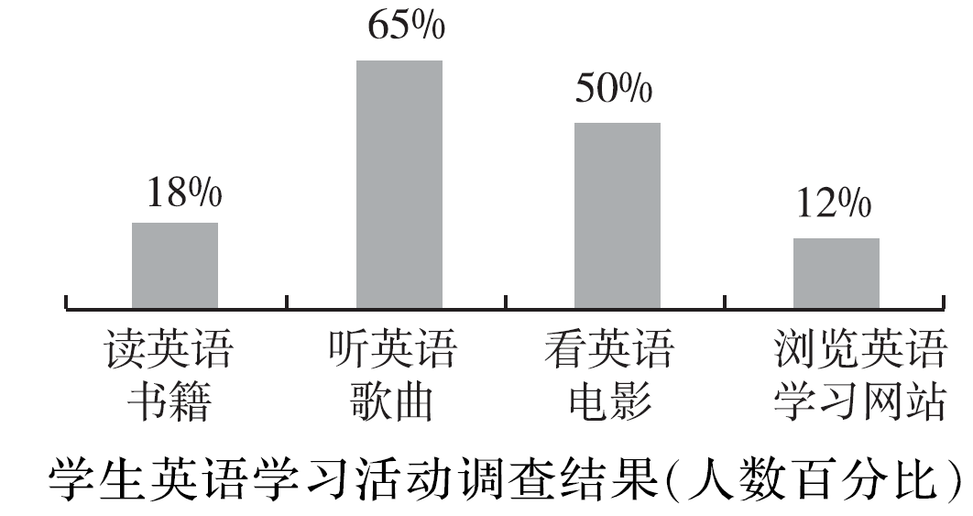
专题导读
注意: 1.词数100左右;
2.短文的题目和首句已为你写好。

Slide 8
Learning English beyond the classroom
There are many things we can do to learn English well.________
____________________________________________________________________________________________________________________________________________________________________________________________________________________________________________________________________________________________
专题导读

Slide 9
[经典范文]
Learning English beyond the classroom
There are many things we can do to learn English well. The results are clearly shown in the chart: among the four types, listening to English songs and watching English movies account for 65% and 50% respectively, leaving reading English originals or accessing English learning websites far behind—only 18% and 12%.
专题导读

Slide 10
This phenomenon shows that the top two combine entertainment and relaxation while the rest two choices mean much harder and more painstaking although they are more fruitful and rewarding.
From where I stand, for us students, what benefits us most in learning English is reading different categories of English books, ranging from biographies of celebrities, classics to popular science. Therefore, make it a point to read extensively beyond the classroom and we can reap more than we expected.
专题导读

Slide 11
【提分句式】
说明图表内容的句型:
1. The graph/chart/table above shows…
2. From the above graph/chart, it can be seen that…
3. As the survey results show, …
4. The key findings taken from the surveys are as follows…
5. As can be seen from the diagram, great changes have taken place in…
专题导读

Slide 12
6. The data/statistics/figures lead us to the conclusion that…
7. It is apparent/clear from the figures/statistics/table/chart/diagram/graph figures (that) most…
8. According to the figures given in the table, online shopping is gaining more popularity/is increasingly popular.
表示变化/比较的句型:
1. There was a great/slight increase/rise in …
专题导读

Slide 13
2. There has been a sudden/slow/rapid fall/drop in… It is 20% lower/higher than…
3. The number/rate has nearly doubled, as against that of last year.
4. It increases/rises/decreases/reduces by… times/… per cent/2/3.
5. The number sharply goes up/down/increases/decreases to…
6. The graph above shows that there was a gradual growth in the number of students last year who attended online courses, reaching the peak at 2.3 billion.
专题导读

Slide 14
说明原因的句型:
1. There are some/two/many good reasons for…/to do…
2. A number of factors could account for …
3. There are several causes for this significant growth in… First…
4. Because/As/Now that/Since the demand has increased, the prices are higher.
5. Generally speaking, there are several reasons accounting for this phenomenon.
专题导读

Slide 15
结尾句型:
1. In a word/In short/In summary, …
2. Generally speaking, …
3. From what has been discussed above, we can draw the conclusion that …
4. I suggest the government take effective measures to …
5. Personally, I believe that traditional methods of teaching and online learning both have advantages and disadvantages.
专题导读

Slide 16
【模拟演练】
近期,你就影响选择大学和专业的考虑因素在高三学生中做了调研,结果如图所示,请结合图表信息写一份调研报告,须包括以下内容:
1.图表产生的背景和基本内容;
2.就你个人而言,你会考虑哪些因素?请列出其中你认为相对重要的两项因素,并说明理由。
注意:1.词数80左右;
2.开头已给出,不计入总词数。
专题导读

Slide 17
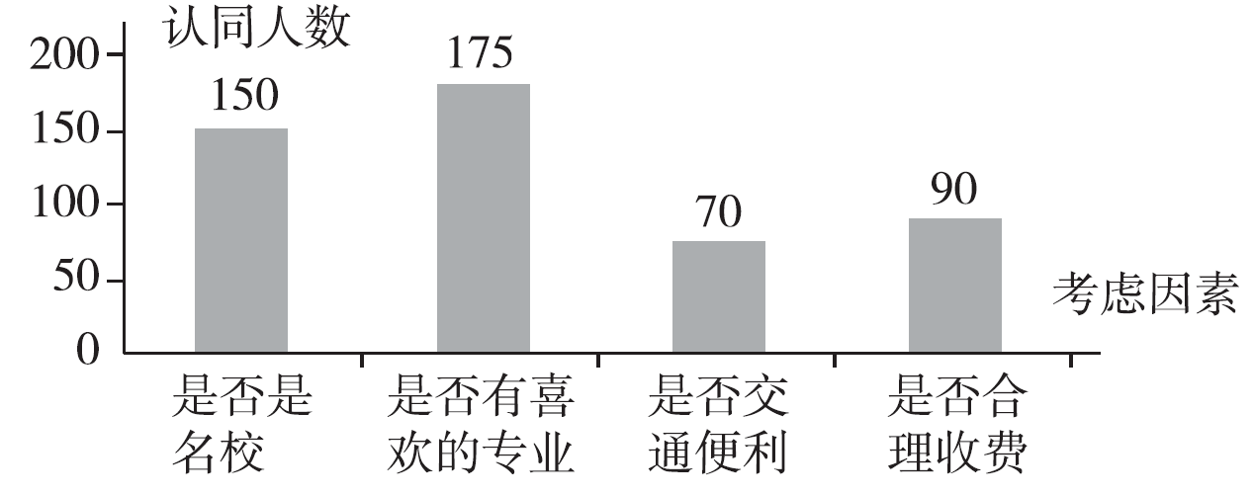
专题导读

Slide 18
With the College Entrance Examination approaching, some senior middle school graduates have different opinions on how to choose their majors and universities._________________________________ ________________________________________________________________________________________________________________________________________________________________________________________________________________________________________________________________________________________________
________________________________________________________________________
专题导读

Slide 19
One possible version :
With the College Entrance Examination approaching, some senior middle school graduates have different opinions on how to choose their majors and universities.
According to the research, about 175 students insist that the choice should be based on their own interest. They say interest is the way leading to success. However, 150 students believe that whether the college is famous is the most important.
专题导读

Slide 20
Only in a famous college will they be able to have a good job in the future. 90 students, however, consider it is the amount of the fee that matters a lot. Interestingly, 70 students think it is important whether to go to the school is convenient.
In my opinion, interest is the most important of all. Besides, the advice offered by parents or teachers is well worth considering because they have more social experience than us. So we should attach great importance to their advice.
专题导读

